Slide 1
Dolores River Restoration Partnership Meeting
October 28, 2014
Dolores, CO

Slide 2
Overview of 2014

Slide 3
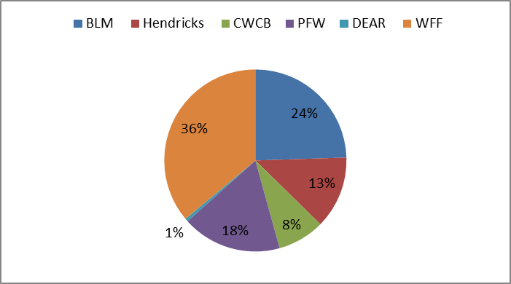
2014 Funding Sources

Slide 4
Overview of 2015/2016 *these are projections subject to change*
2015
2016
WFF – Walton Family Foundation
BLM AA – Bureau of Land Management Assistance Agreement
HFF- Hendricks Family Foundation
NFWF – National Fish and Wildlife Foundation
HLI - Healthy Lands Initiative

Slide 5
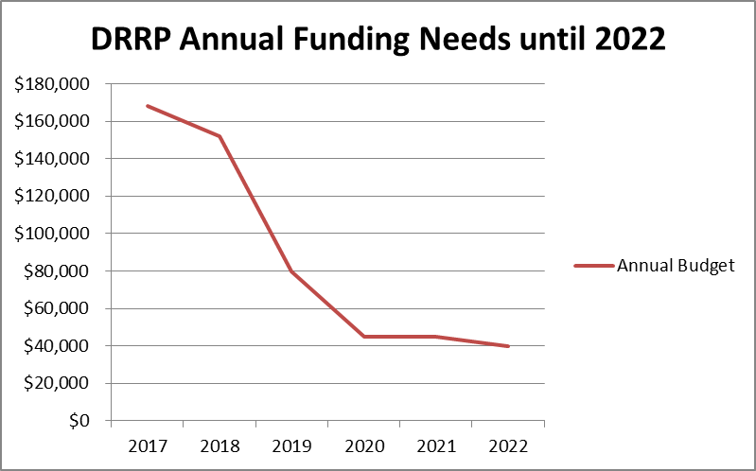
Projected Long-term Partnership Expenses

Slide 6
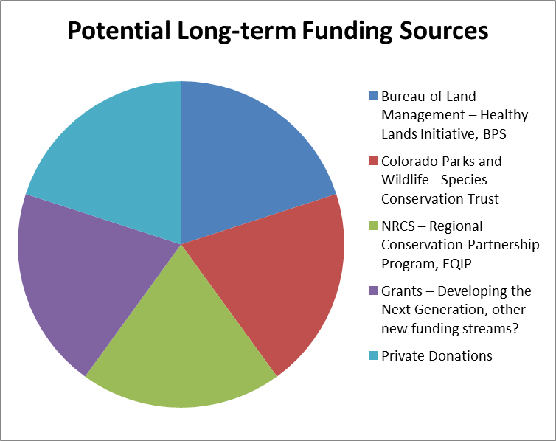
Funding the Transition Plan (and beyond)

Slide 7
Fundraising Challenges
Capacity and monitoring work is the most challenging to fund
Grant funding sources are becoming less reliable
The DRRP does not have a strong existing donor base
The Dolores River is located in a rural, sparsely populated area – will be challenging to find funding at the level needed locally
The DRRP could be competing with other partnerships and organizations for private/individual donations
The DRRP will need added capacity over a multi-year period to be able to implement a successful private/individual donor campaign

Slide 8
Colorado Collaboration Award
$50,000 of discretionary funding
Provides a unique opportunity for the DRRP leverage funds and develop a private/individual donor campaign
Goal: leverage the CCA money as opposed to spend it in the near term
Funds could serve as “seed” funding for the creation of a “Partnership Fund”
Funds could be matched and used to hire a Development Director/Communications Plan
Core Team to develop a strategy to maximize these funds

Slide 9
Next Steps
Funding Subcommittee will continue researching and applying for grants
BLM working Healthy Lands Initiative and budgeted funds
Funding Subcommittee working on replenishing Species Conservation Trust fund
Core Team devising private donor strategy (using CCA $?)
Core Team conducting feasibility study on “Partnership Fund” concepts – e.g. endowment, revolving loan fund, other?

Slide 10
QUESTIONS?

